Slide 1
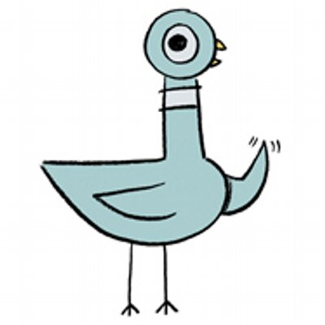
Don’t Let the Pigeon
Make this PowerPoint!
Don’t mind me.
I’m just here to watch…

Slide 2
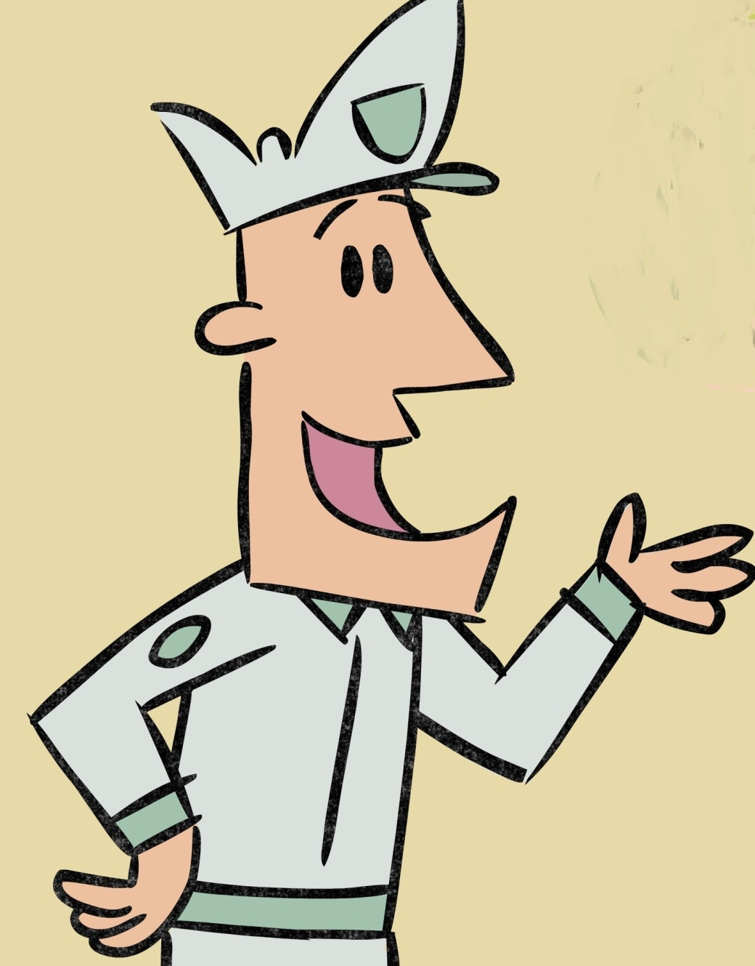
Hi! I’m the Bus Driver. Can you do me
A favor? Can you make sure the pigeon doesn’t make this Powerpoint because he will mess it up.
Thanks!

Slide 5
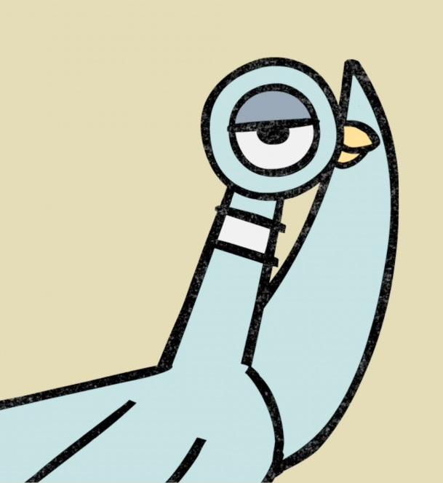

Slide 6
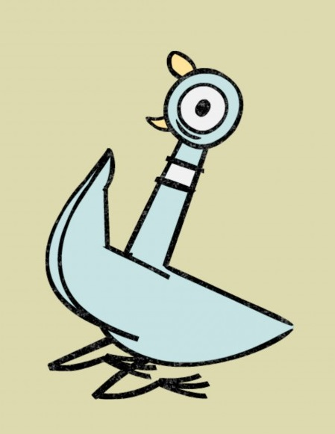

Slide 7
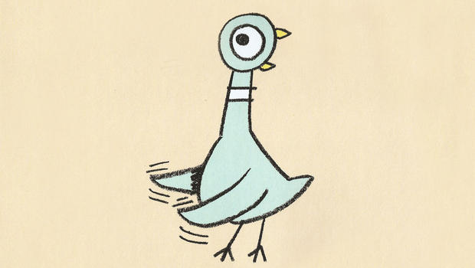

Slide 8
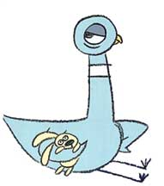

Slide 10
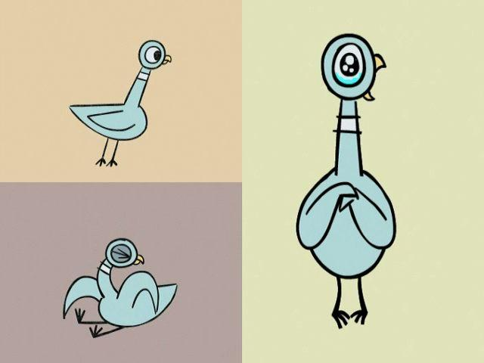

Slide 11
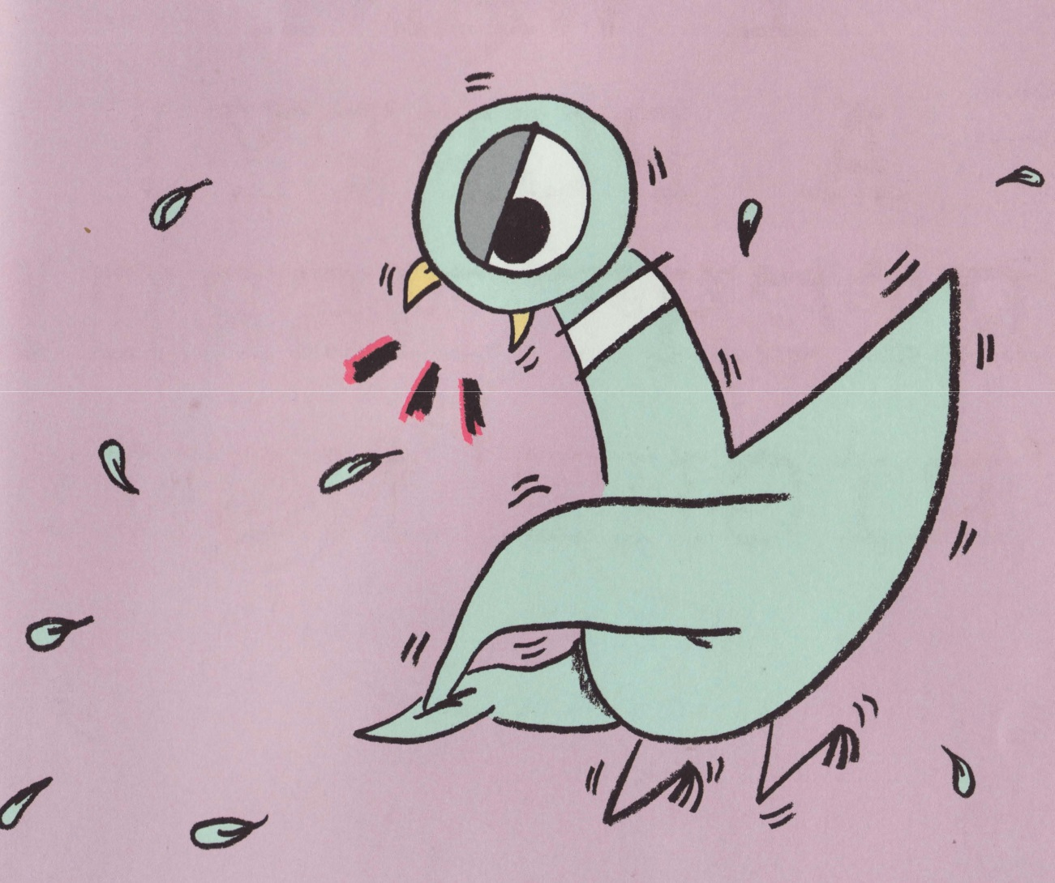

Slide 12
